Slide 1
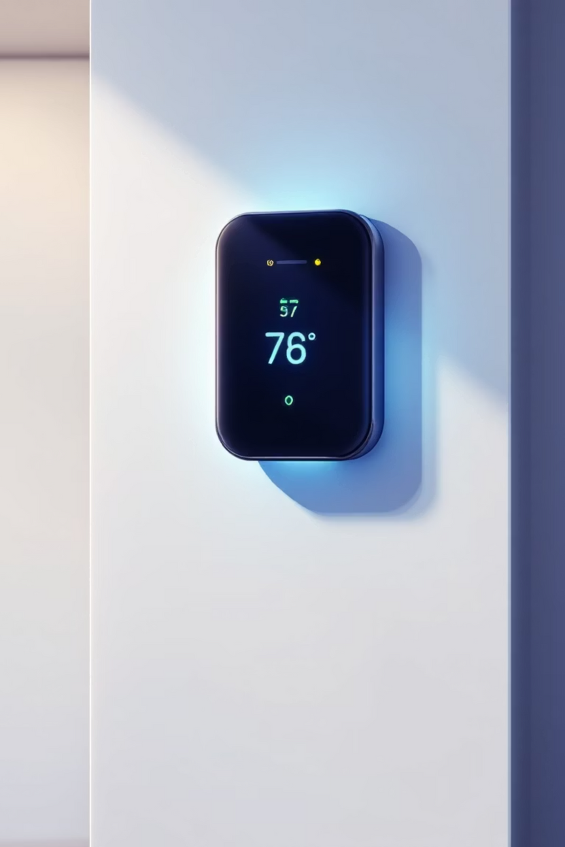

Smart Thermostat using ESP8266 and Blynk
An IoT-enabled climate control system for automated temperature regulation and remote monitoring
Team: Bonthala Rohith Kumar, Ch. Pramodh, M. Chandra Vardhan, B. Bindu
Supervisor: Prof. Dr. Krishnamoorthy A.
1
Notes:
1

Slide 2

Project Overview
The Challenge
Our Solution
Traditional thermostats lack connectivity and intelligence, leading to energy waste and inconvenience. Users cannot monitor or control temperature remotely, resulting in inefficient climate management.
An IoT-based smart thermostat using ESP8266 NodeMCU, DHT sensor, and Blynk cloud platform. Enables real-time monitoring, remote control, and automated temperature regulation from anywhere.
2
Notes:
2

Slide 3




Core Objectives
Accurate Sensing
Cloud Integration
Interface DHT11 sensor with NodeMCU for precise temperature and humidity data acquisition
Establish reliable Wi-Fi connection and transmit data to Blynk cloud for real-time visualization
Remote Control
Smart Automation
Enable users to set temperature thresholds and override appliance control via mobile app
Implement hysteresis control logic to prevent rapid relay cycling and enhance system stability
3
Notes:
3

Slide 4
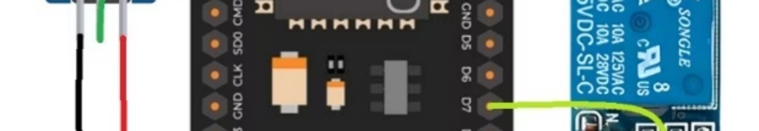
System Architecture
01
02
Physical Layer
Network Layer
DHT11 sensor and relay module interface with physical environment
ESP8266 Wi-Fi module establishes connection and transmits data via TCP/IP
03
04
Cloud Layer
Application Layer
Blynk cloud authenticates device, stores data, and processes commands
Mobile app provides GUI for visualization and control
4
Notes:
4

Slide 5
Hardware Components
NodeMCU ESP8266
DHT11 Sensor
5V Relay Module
32-bit microcontroller with built-in Wi-Fi serves as central controller for data acquisition and communication
Measures environmental temperature (±2°C accuracy) and humidity (±5% accuracy) every 2 seconds
Opto-isolated single-channel relay switches AC/DC load based on NodeMCU control signal
5
Notes:
5

Slide 6





System Workflow
Connection
NodeMCU connects to Wi-Fi and establishes link with Blynk cloud server
Sensing
DHT11 sensor periodically measures temperature and humidity
Transmission
Sensor data sent to Blynk cloud and displayed in real-time on mobile app
Control
NodeMCU compares measured temperature with user-defined threshold
Actuation
Relay switches appliance ON/OFF based on control logic with hysteresis
6
Notes:
6

Slide 7
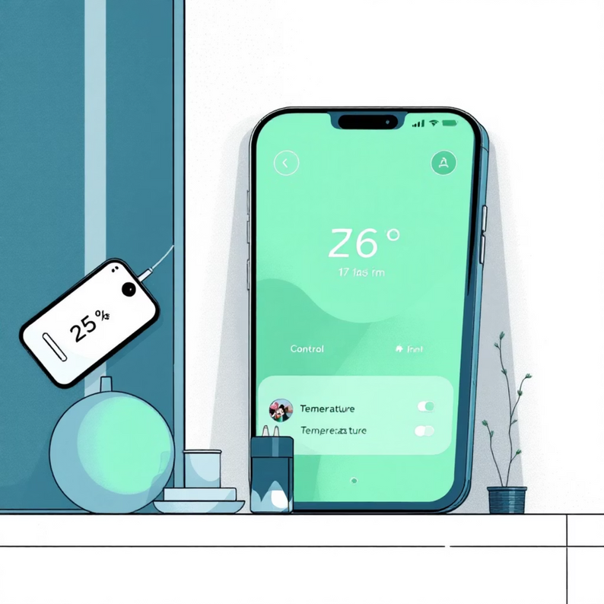
Key Features & Advantages
Real-Time Monitoring
Remote Control
View live temperature and humidity data from anywhere via Blynk app
Manual override and automatic operation based on user-defined setpoint
Hysteresis Control
Cost-Effective
±0.5°C margin prevents rapid relay switching, ensuring stability and longer component life
Built with affordable off-the-shelf components, significantly cheaper than commercial alternatives
Scalable Design
Modular architecture allows future expansion and integration with other smart home platforms
7
Notes:
7

Slide 8

Testing & Validation
10
100%
2s
Test Cases
Success Rate
Response Time
All functional requirements validated
Every test passed successfully
System reacts within 2 seconds
2hr
Stability Test
Continuous operation without failure
Comprehensive testing included unit testing, integration testing, and system-level validation. The hysteresis control successfully prevented relay chatter, and auto-reconnect functionality restored connection within 30 seconds after network disruption.
8
Notes:
8

Slide 9
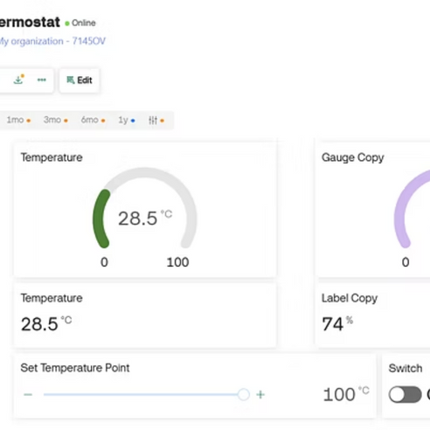
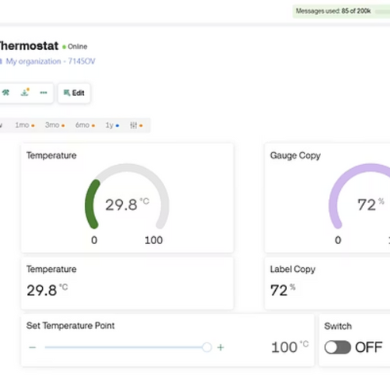
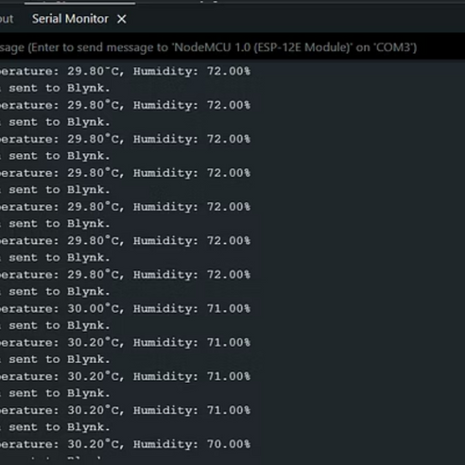
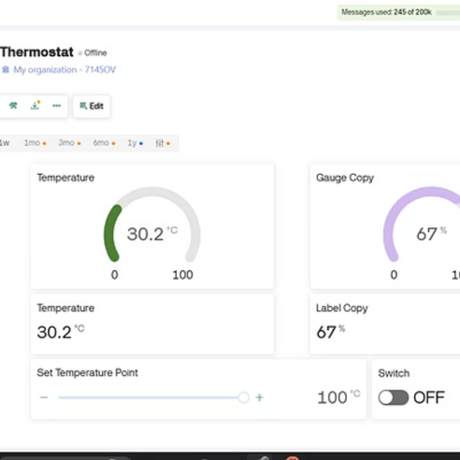
Results & Interface
The Blynk dashboard provided clean, responsive interface with 2-second update intervals. Temperature gauges reflected real-time conditions accurately. With setpoint at 27°C and ±0.5°C hysteresis, the fan reliably activated above 27.5°C and deactivated below 26.5°C.
9
Notes:
9

Slide 10




Future Enhancements
Machine Learning
Voice Control
Predictive temperature control based on user behavior patterns and preferences
Integration with Alexa and Google Assistant via IFTTT for voice commands
Local Display
Energy Analytics
OLED screen for offline monitoring and control when internet connection is unavailable
Power consumption monitoring with SCT-013 sensor for usage insights and cost tracking
Conclusion: This project successfully demonstrates a low-cost, IoT-enabled smart thermostat that provides remote monitoring, automated control, and enhanced convenience. The system serves as a scalable foundation for advanced smart home climate control solutions.
10
Notes:
10

